Slide 1

Humana Healthcare Competition
Mohanaditya Karampudi
(MO)

Slide 2

Process Flow
Problem Statement
Data Overview
Feature Engineering and Exploratory Data Analysis
Build & Optimize ML models
Validate the Performance
Insights and Recommendation

Slide 3
Where to use ML
A | B | C | D | Outcome
0 | 1 | 0 | 0 | point
1 | 1 | 0 | 0 | Line
1 | 1 | 1 | 1 | Quadrilateral
1 | 1 | 1 | 1 | Quadrilateral
0 | 0 | 1 | 1 | Line
0 | 1 | 1 | 1 | Triangle
1 | 1 | 1 | 0 | Triangle
1 | 1 | 1 | 1 | Quadrilateral

Slide 4
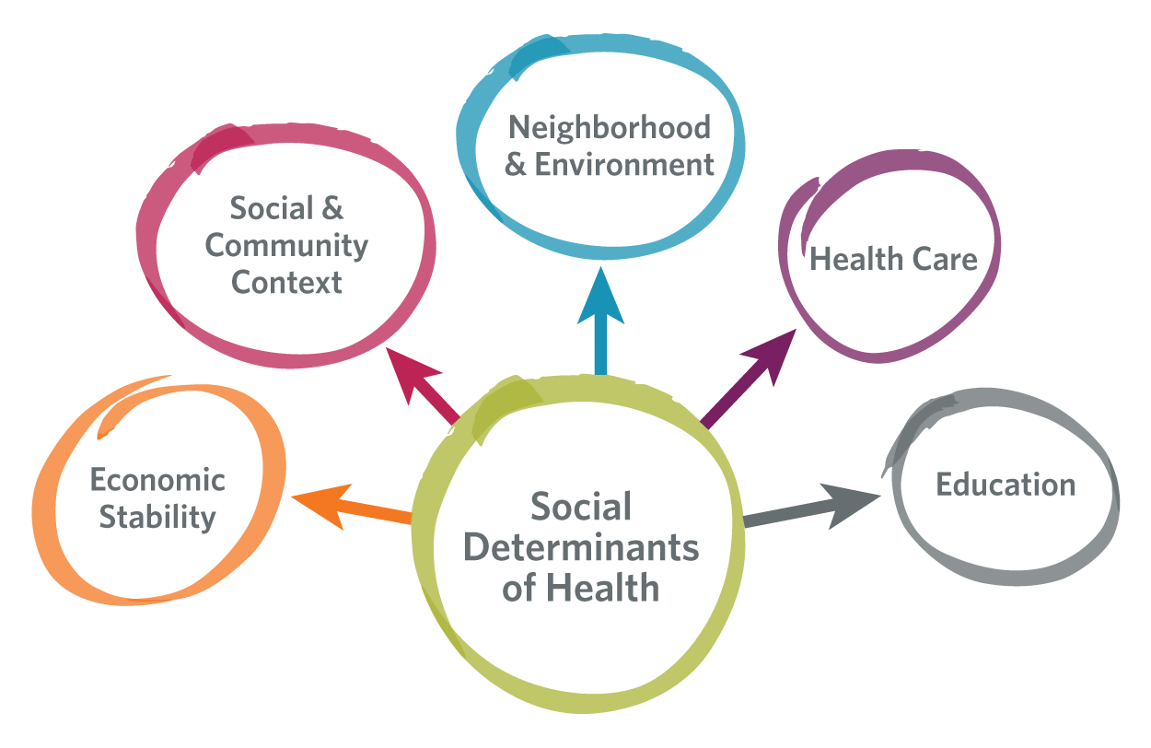
Problem Statement & Goal
Social Determinants of Health are one of the key component in Humana’s integrated value-based health ecosystem.
Transportation – A Social Determinant of Health (SDOH) factor
Q - In the past 12 months, has a lack of reliable transportation kept you from medical appointments, meetings, work or from getting things needed for daily living - Yes/No
Goal - Identify members most at risk of facing transportation challenge

Slide 5
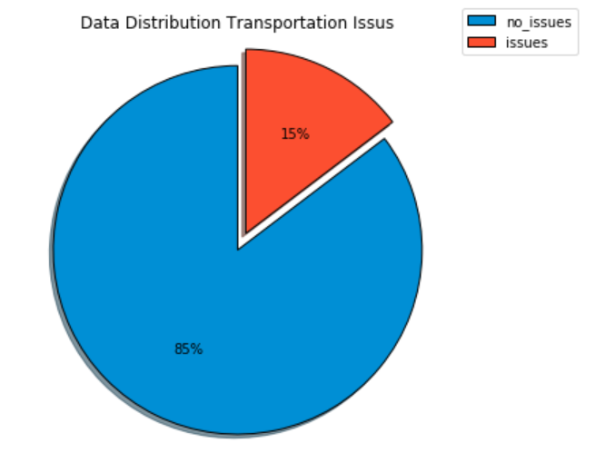
Data Overview
1 Year data from Humana Medicare Advantage and Prescription Drug (MAPD) plan
Training dataset of 69572 rows and 826 columns of augmented data
Features scattered across
Medical Claim Features (MC)
Pharmacy Claim Features (PC)
Demographics/Consumer data (Demo)
Condition related features (CR)
Data Distribution of Transportation Issue
There are two key types of features across multiple categories:
IND - Binary indicator for different scenarios (Yes - 1/ No – 0)
PMPM – Per member per month sheds light on the proportion of the services utilized by members
85% of the members do not face transportation issues

Slide 6
Breakdown
Transportation Challenge
Medical Claim (1)
Pharmacy Claim (1)
Consumer data (2)
Condition related (1)
CCSP (2)
Betos (1)
Proportion days covered (2)
Mailed/Non-Mailed (3)
Drugs (2)
Age (3)
Behavioral Health (2)
Gender (3)
Smoker (3)
MCC (2)
1 – Highest level that has a category below it
2 – Middle most layer with features below it
3 – Individual features of members
Notes:
Talk about the levels of data present and why you did not show the lowest levels of data
HIERARCHIAL STRUCTURE OF DATA

Slide 7
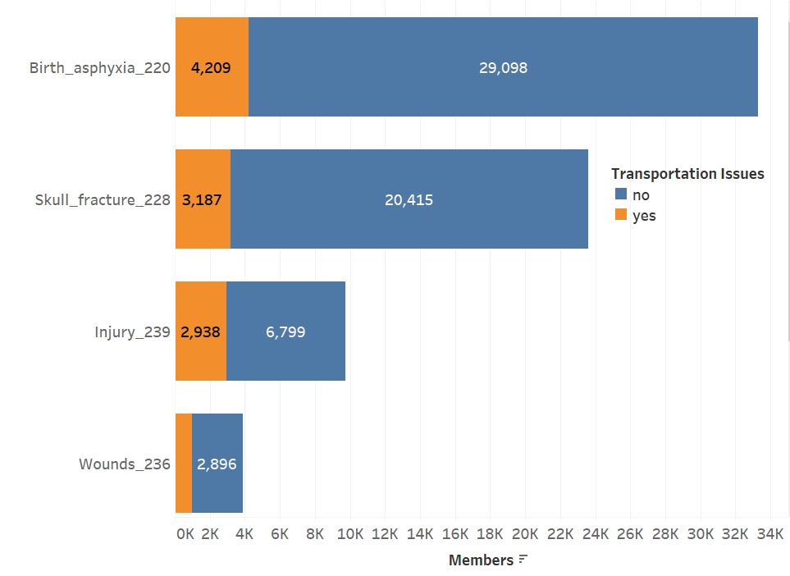
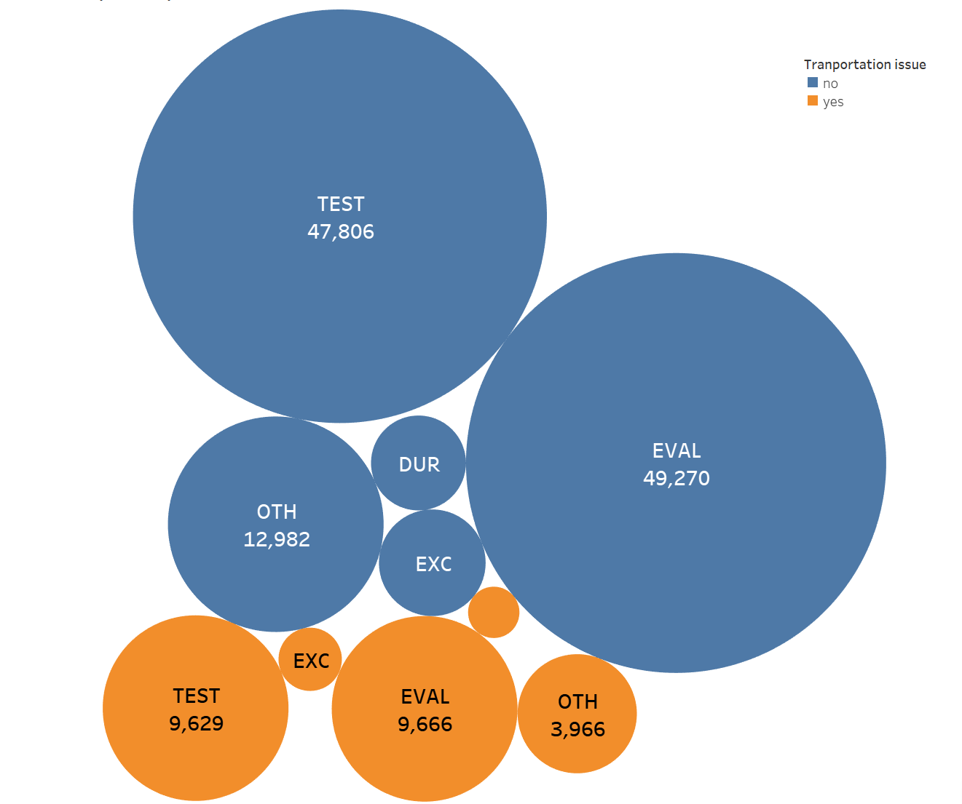
Medical Claim features
Clinical Classifications Software (CCS) (2)
Medical Diagnosis and Procedures collapse into a smaller number of clinically meaningful categories
21 categorical features in the data (3)
BETOS (Berenson-Eggers Type of Service) (1)
Medical Expenditure across services and to analyze the Medicare costs
5 categories (2) – test, eval, dur, oth, exc
17 categorical ind features (3)
17 numerical pmpm features (3)
72% of the members availed at least one of the CCSP services (out of 21) and 15% of them had transportation issues.
Notes:
CCS can be used to identify populations for disease- or procedure-specific studies – The type of procedure a member has gone through reveals information about the condition of the member and thus it can have effect on the transportation issue.
A binary indicator - whether the member used any of the CCS service
Total number of diagnoses services a member has availed
All Health Care Financing Administration Common Procedure Coding System procedure codes are assigned to a BETOS category.
The type of tests conducted on the member provides insights into the medical conditions that may affect chances of facing transportation issues. What kind of tests were done on the patient, the medical equipment used etc.
yes_no - binary indicator - did the member use any service in each category
yes_no_sum - total services a member used across all the categories
pmpm_sum - sum of PMPM for all the services the member used in each category.
These share information about the pmpm cost of visits to each medical room. While this is actually a continous attribute, I have presented plot of just the count of number of visits.
WHAT PROBLEM STATEMENT, THR CREATIVITY, MAJOT CHALLENGES, AND LET THEM KNOW HOW DIFFICULT THIS WAS.
SPENT SHOURS AND UNDERSTOOD THE FEATURES. DATA SIZE, WE HAD LIMITED TIME

Slide 8
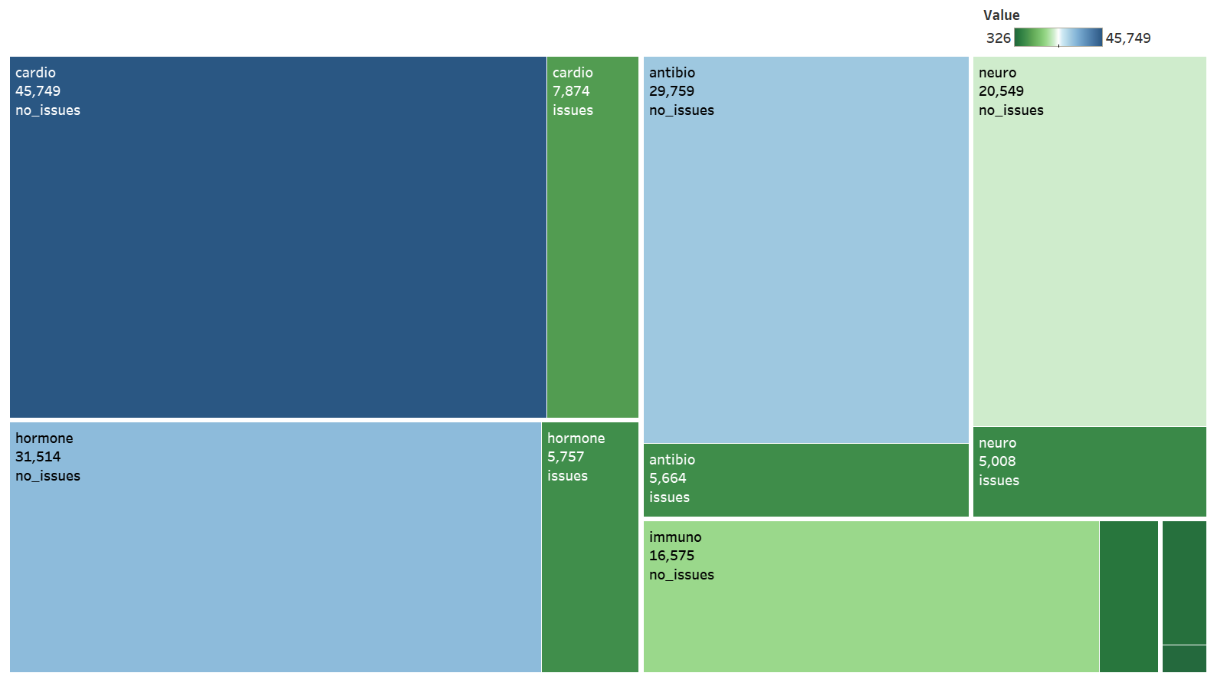

Pharmacy Claims
Prescription Days Covered – High NA Values
Mailed/Non-Mailed (3)
If the Drugs are delivered through mail or by in-store pickup
87% (60824) of the members request mailed prescription and 14% (8513) of them face transportation issues
Drugs (1)
Type of drug and quantity ordered
95 categorical (3) ind features crunched into 18 categories (2)
95 categorical pmpm (3) features converted into 18 categories (2)
Quantity of orders for multiple drugs
Antibiotics | Immunomodulators | Cancer
Hormonal | Cardiovascular | Kidney
Allergic | Respiratory | Intestinal
Neuropharmacological | NSAIDS | Anesthetics
Hematopoietic agents | Hematopoietic agents | Blood Related
Eye | Ear | Others
Person id - 225de3M2OSd6ea8T54LYA1I9 ordered 15 out of 18 drug categories
Notes:
After connecting with them – high NA values

Slide 9
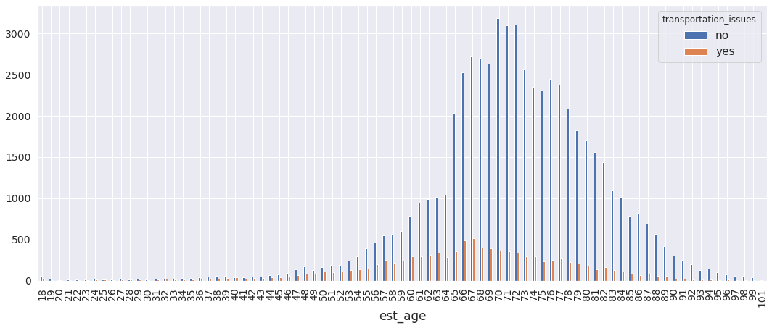
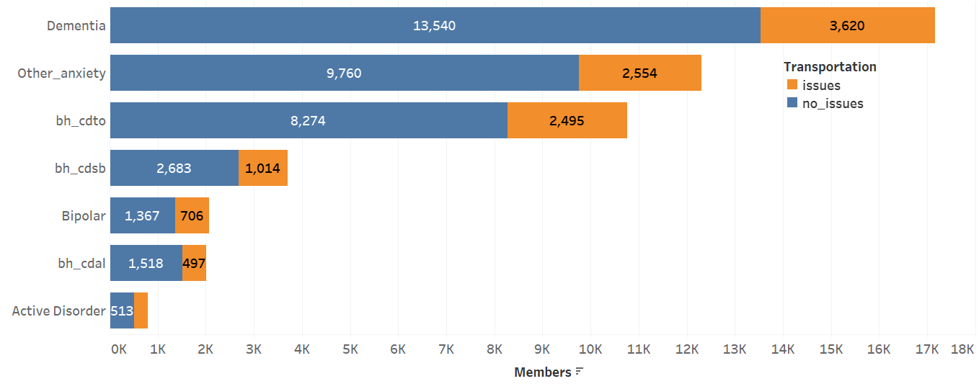

Consumer, BH
Distribution of Age across dependent variable
5 categorical features (3)
Features | % Members having Transportation issue
Male | 7.4
Female | 6.4
Current Smoker | 4.2
Not A Current Smoker | 7.5
Urban Region | 6.7
Rural Region | 7.3
Frequency of Behavioral Issues broken by Transportation
Behavioral Health Condition
The type of behavioral issue a member has been diagnosed with
7 categorical features (3) – Dementia, anxiety, cdto, csb, bipolar, cdal and active disorder
Three members have all of the behavioral issues (MO5S536T49e24f3L027Y37AI, bM4OfbS1Te347339LY13AIac and d4MOST0L18c896Y7A9Idc7d2)

Slide 10
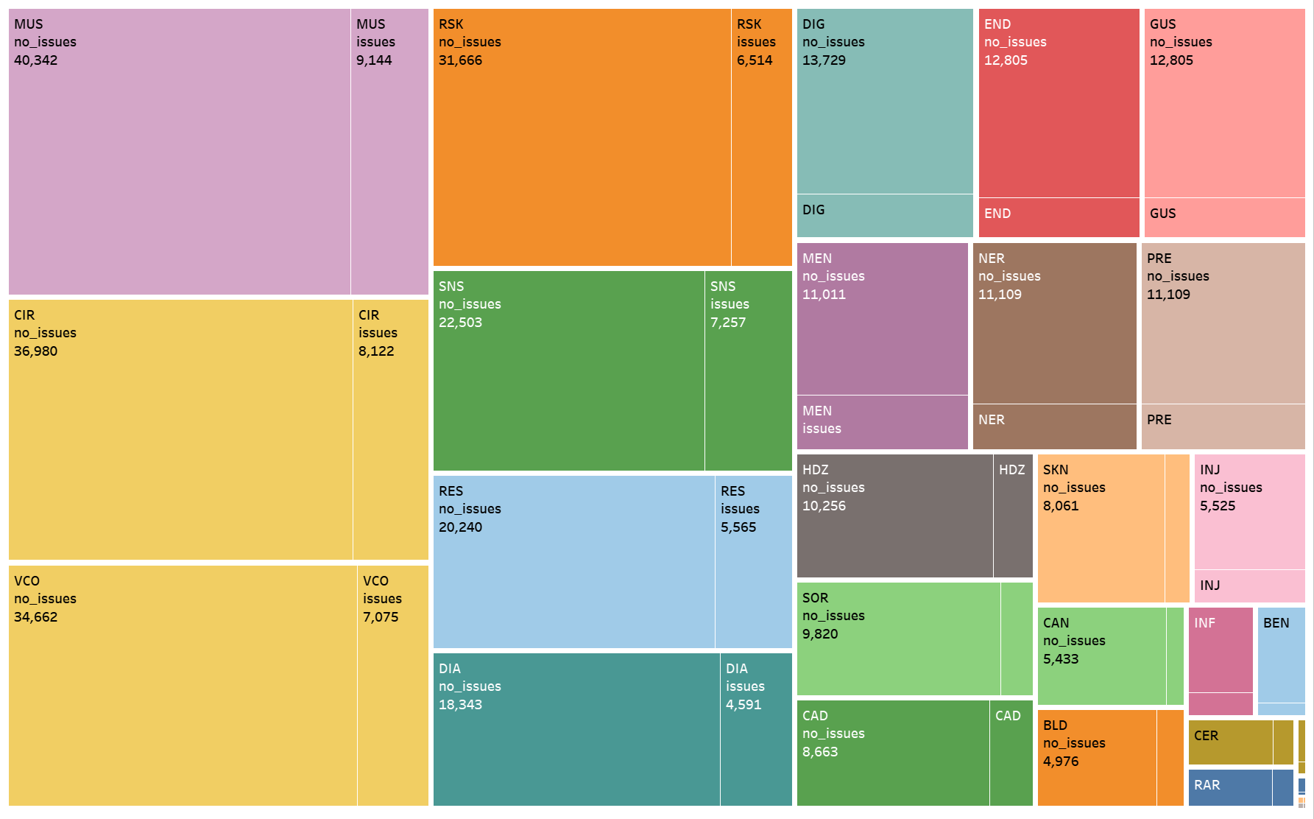

Condition Related
Major Clinical Categories (1)
Presence of two or more medical conditions in a patient.
28 Categories (2) –
171 categorical ind features (3)
171 numerical pmpm features (3)
Various MCC categories and their relationship with transportation issue
DIG – Digestive (2)
Liver
Lower - Gastro
Other
Pancreas
Upper - Gastro
Categories in Digestive MCC
Most number (82) of MCC was present for fM3O00b0S6a12dTLYA032bIe

Slide 11

Model Building
Executed multiple models on subsets of data and shortlisted 138 attributes
Random stratified train-test split with 85-15
Class Imbalance – Base accuracy of 85%
Undersampling
Oversampling
SMOTE
Standardized and encoded
Models used - Logistic, Balanced Bagging, Random Forest, Xgboost and Light GBM using 5-Fold cross validation
Light GBM with the following parameters
Epochs = 1000
colsample_bytree = 0.8
learning_rate = 0.02
max_depth = 8
reg_lambda = 1.0
subsample = 0.7
Notes:
Initially built random forest for each set of features
Selected top performers – Because of this we lost the interaction effect of attributes, decision due to time and resource constraint
Class imbalance problem - employed
Google Cloud Platform and H20 driverless AI for training multiple models
Parameters for final model
Data split
Just 138 features
Base accuracy was 85%
Final model AUC 0.77 and 72.5% accuracy on balanced class

Slide 12
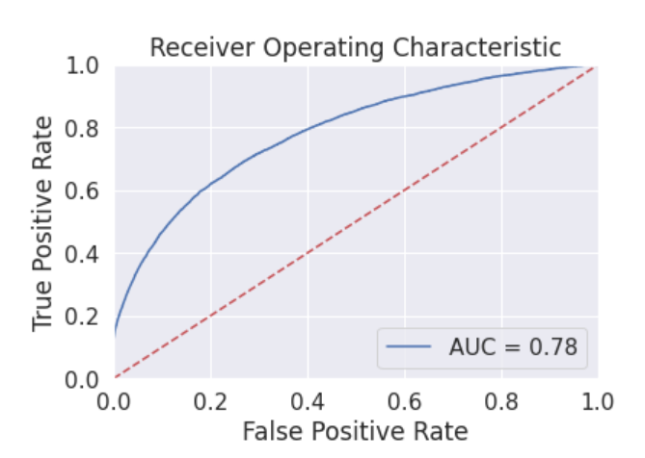
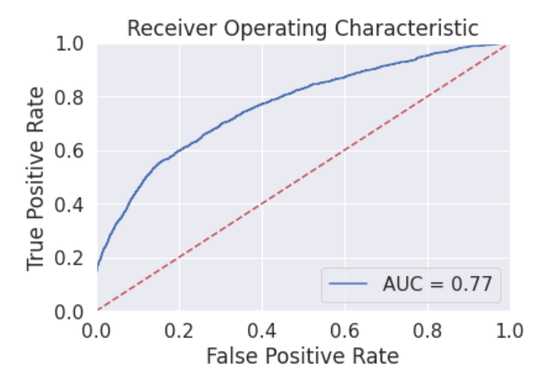

Validation
 | Light GBM | Logistic
Train (106,510 data rows – 0 ,1:53K)
AUC | 0.78 | 0.73
F-1 Score | 0.70 | 0.68
Precision | 0.72 | 0.64
Recall | 0.68 | 0.61
Test ( 10,042 rows - 0:8513, 1:1529 )
AUC | 0.77 | 0.73
F-1 Score | 0.42 | 0.40
Precision | 0.31 | 0.29
Recall | 0.66 | 0.61
Train Dataset
Test Dataset
Notes:
Talk about the way logistic did great
The AUC metric compared to all other scores.

Slide 13
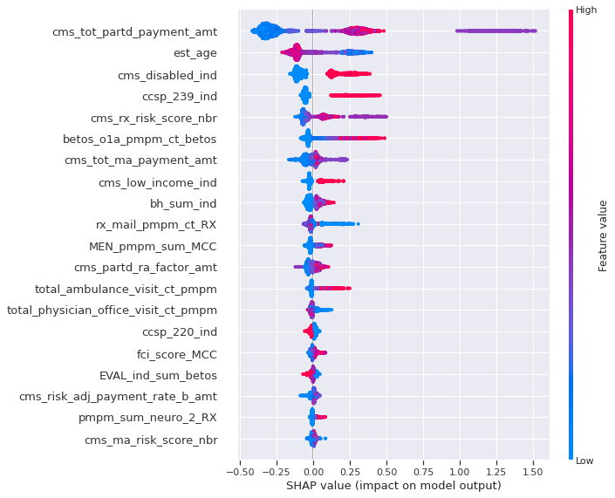
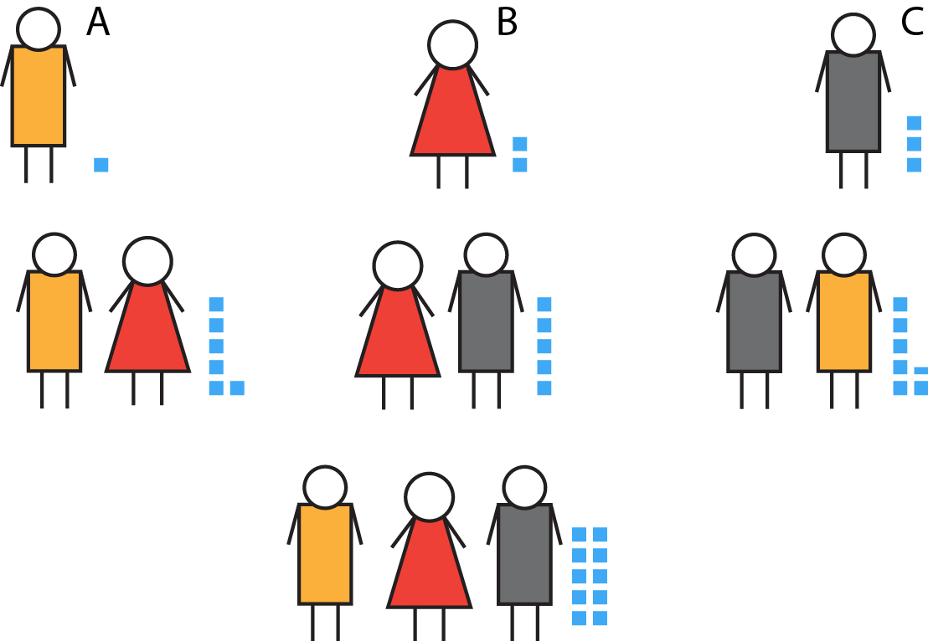




Insights
SHAP value impact on model output
Positive Contributors
cms part d payment
cms disabled indicator
ccsp superficial injury
betos other ambulance
Negative Contributors
age
ccsp hypoxia
betos evaluation indicator

Slide 14
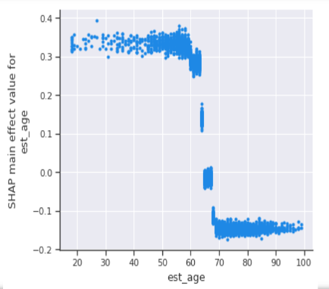
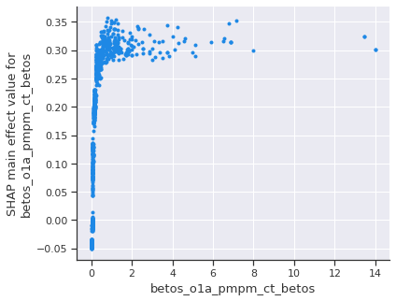
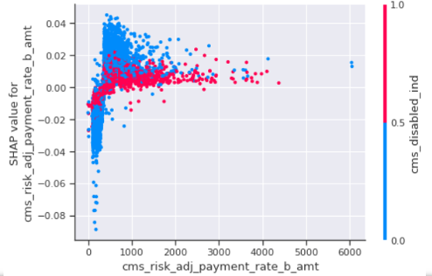
Insights and Recommendation
Shapley for Age
Shapley for betos ambulance pmpm count
Interaction between CMS part B and Disability
Age threshold 65
Betos ambulance pmpm greater than 1
Member is disabled and CMS part B amount > 500$

Slide 15

Improvements
More understanding about the data
Include Financial Information
Add few more critical features especially in demographics
More complex model by training all attributes
Individual level analysis using Shapley
Threshold using Cost Matrix
Discussion with Domain Experts

Slide 16

Challenges
No Domain Expertise
Limited Time and connectivity
Huge Data
Computation challenges
Feature generation
Modeling approach
Interpreting model in business context

Slide 17

Teammates
Neti Sheth (LinkedIn) | (GitHub)
Sai Suraj (LinkedIn) | (GitHub)
References
http://health.utah.gov/opha/IBIShelp/codes/CCS.html
https://www.cms.gov/newsroom/fact-sheets/medicare-part-d-direct-and-indirectremuneration-dir
http://www.hpoe.org/resources/ahahret-guides/3078
https://www.ensocare.com/knowledge-center/how-demographics-impact-health-caredelivery
https://www.cms.gov/Research-Statistics-Data-and-Systems/Statistics-Trends-andReports/MedicareFeeforSvcPartsAB/Downloads/BETOSDescCodes.pdf

Slide 18




Q & A

